Slide 1

Language Translation
Machine Translation

Slide 2

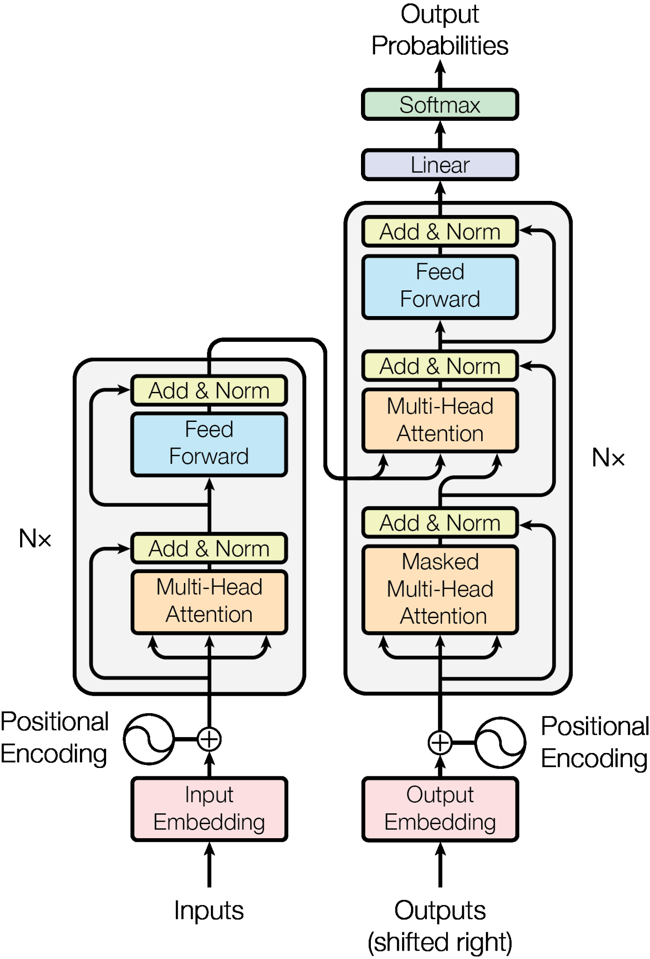
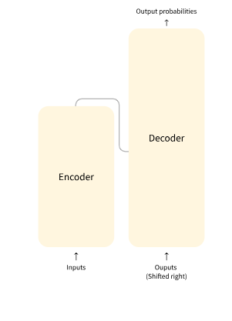
How do Transformers work?
SEQUENCE - SEQUENCE
TRANSFORMER

Slide 3

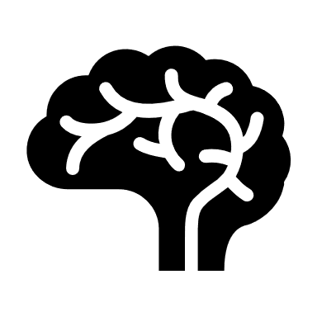
Neuron workflow of ENCODER - DECODER
PRE-PROCESS
EMBEDDING
ENCODER
Word-vector
DECODER
I LOVE *masked*
MASKING
I *probability* - my country , myself , person

Slide 4
GOOGLE TRANSFORMER MODEL
Why do we need Language translation and Model Behind
Lets begin Hand-On - colab

